Slide 1

ONLINE NEWS POPULARITY
Group III
Krupa Shetty
Tharshini
Vishal Ghosh
Shishira A V\
Sushil

Slide 2



HOW MARKETING STRATEGY GOT CHANGED
How do Blogging websites generate revenue?
Different methods from which these websites generate revenue are the following :
Display Ads
Private Ads
Pay-per-click
Sponsored content
Digital Product sales
Before
Now

Slide 3
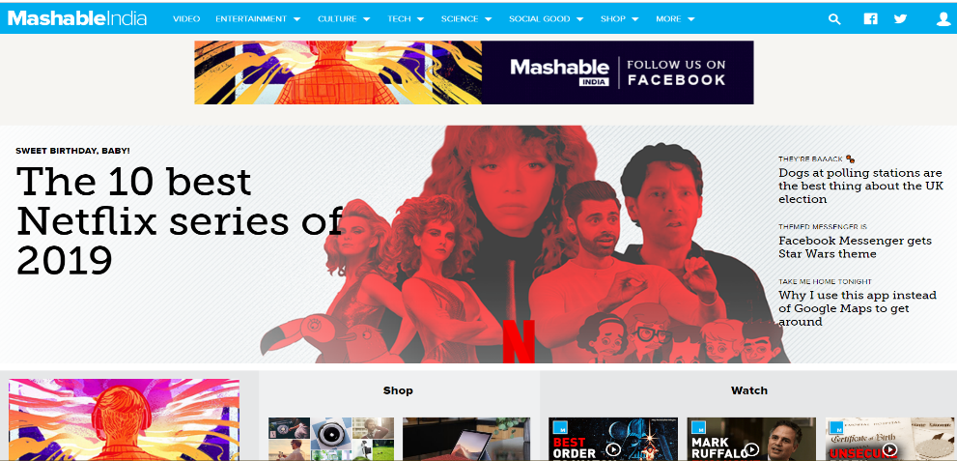
Data description and Problem Statement
Data Source :
Mashable
Problem Statement:
Problem :
Even though the content of article is good still few articles don’t get good number of shares and displaying Ads with it doesn’t make profit.
Solution :
Popularity prediction of online article aims to predict the future popularity of new article prior to the publication estimating the number of shares, likes and comments that particular article will get depending on various features.
Depending on that we can display Ads with respect to the popularity.

Slide 4

PROBLEM STATEMENT
Predicting the popularity of the article based on number of shares
&
Recommending what changes can be made in the article to become popular

Slide 5

BUSINESS OBJECTIVE
Research and developing methodology for predicting the popularity.
Main objective : Impact on revenue based on popularity of article.
When does the number of share increase?
Which type of blog does consumers like?
Whenever the number of shares are more those patterns will be analyzed. Depending on these patterns action could be taken on understanding how the article should be and thus understanding the customer.

Slide 6
FEATURES
Life of an Article
Tokens, Average length of token, Bag of Words, Nonstop words,
Topic Modeling : Key words, LDA (Latent Dirichlet Allocation )
Subjectivity, Sentiment Polarity
Data Channels
Number of videos and images
Self Reference, Number of Reference to Other Links
Shares on different days of week
Share, Popularity based on shares (target variable)

Slide 7
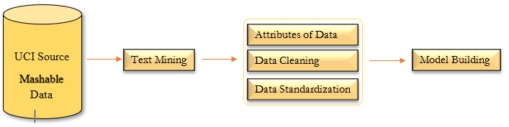
PROCESS
DATA PREPROCESSING:
Select categories from dataset to check the skewness'
Checking for values that comes under 3 sigma zone to detect extreme values
Standardize selected indicators using Standardization
Predicting popularity of each categories based on number of shares

Slide 8
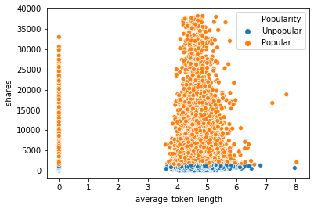
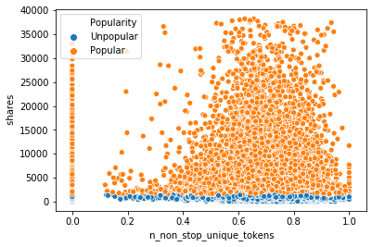
EXPLORATORY DATA ANALYSIS
Rate of frequency of unique words is between 0.4 – 0.8
Rate of frequency of non-stop unique words is between 0.5 – 0.9
Average length of the words in content is between 4 - 5.5

Slide 9
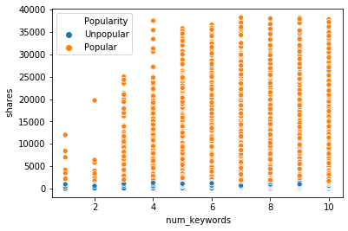
TOPIC MODELING : KEYWORDS
Ex: Amazon: Kindle, Prime, Echo, Alexa, Tab
Keywords play prominent role in popularity of an article
More number of keywords articles are getting shared more
In our case it ranges between 4 to 10

Slide 10
SENTIMENT POLARITY
An article can have both positive and negative polarity which shows the emotions.
More number of positive polarity many intend towards good articles.
More number of negative polarity many towards controversial articles.
POSITIVE CORPUS
“To the world you may be just one person, but to one person you may be the world.”
II. “I now believe global warming alarmists are unpatriotic racists knowingly misleading for their own ends. Good night.”
NEGATIVE CORPOUS

Slide 11
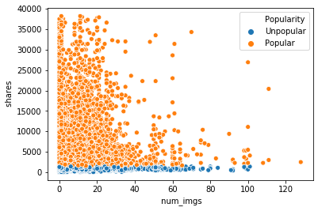
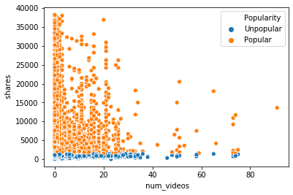
IMAGES & VIDEOS
Image count range between 1-25
Lesser the image sharing is high
Video count range between 1-4
Lesser the videos sharing is high

Slide 12
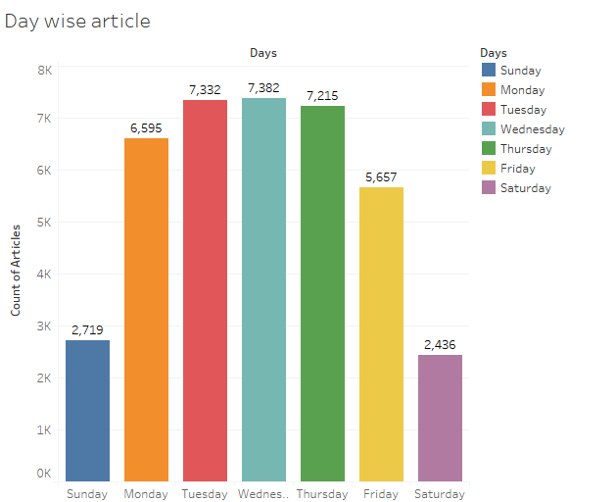
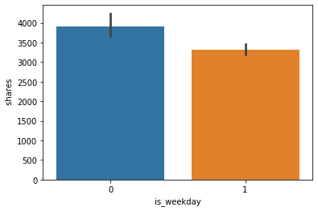
DAY WISE SHARE
Wednesday has maximum articles getting released
Weekdays have maximum number of shares
Weekday (0) : More share
Weekend (1): Less Share

Slide 13
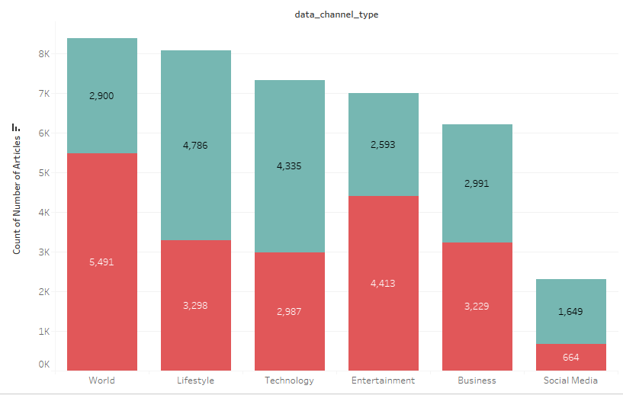
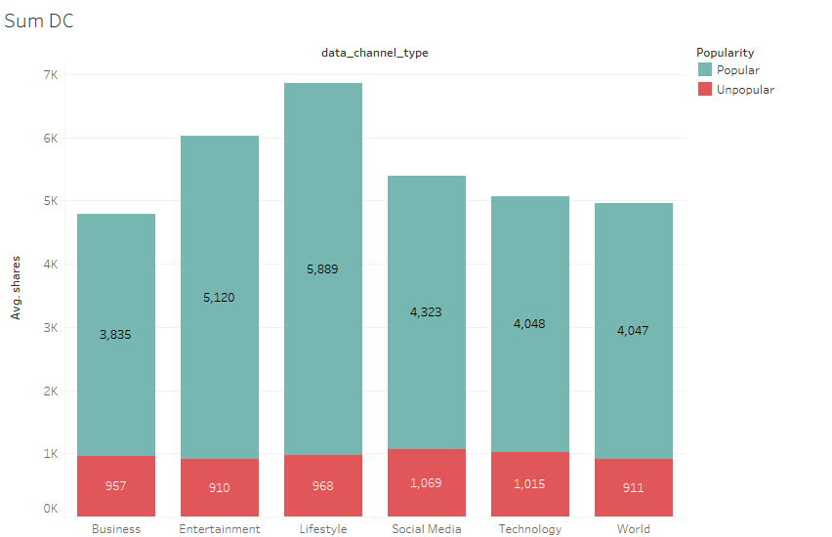
TYPES OF DATA CHANNELS
More number of articles are getting published under data channel “World”
“Lifestyle” has more number of shares.

Slide 14
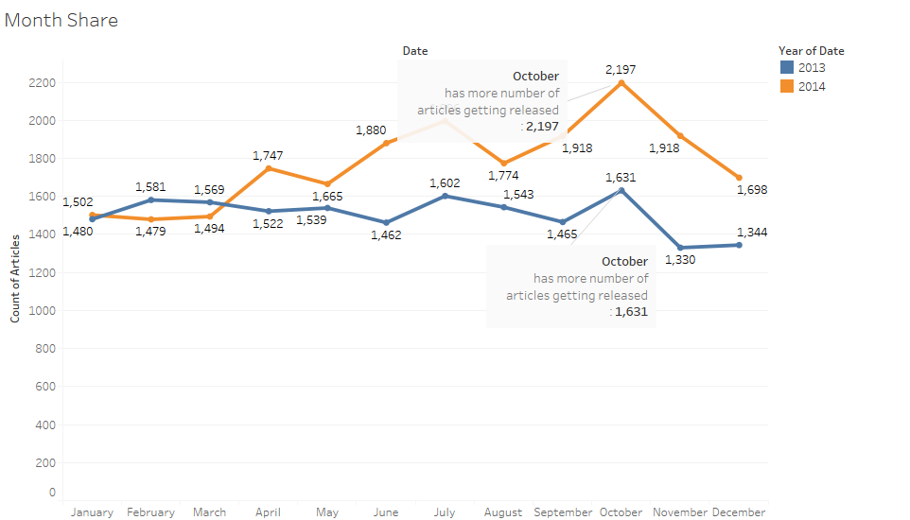
MONTH WISE ARTICLES GETTING PUBLISHED
(2013-2014)

Slide 15
MODEL ACCURACY
Models | Cross Validation (k_fold = 7) | Train Test Split (70:30)
 | ROC_AUC | Train Accuracy | Test Accuracy | Precision |  | Recall
 |  |  |  | Un-Popular | Popular | Un-Popular | Popular
Base Model : Log Reg | 36.00% | 37.00% | 31.00% | 31.00% | 29.05% | 28.00% | 32.00%
Logistic Regression | 68.82% | 68.96% | 63.86% | 65.00% | 63.00% | 66.00% | 62.00%
KNN | 59.07% | 73.00% | 59.00% | 61.00% | 59.00% | 63.00% | 56.00%
Decision Tree | 69.91% | 98.00% | 57.00% | 59.00% | 57.00% | 59.00% | 57.00%
Random Forest | 67.20% | 62.90% | 61.00% | 61.00% | 63.00% | 61.00% | 52.00%
Bagged DT | 67.04% | 100% | 62.00% | 59.05% | 57.45% | 59.90% | 57.00%
Bagged Log Reg | 68.79% | 63.95% | 63.95% | 65.00% | 53.00% | 66.00% | 62.00%
Ada Boost Log Reg | 65.48% | 60.82% | 61.38% | 62.00% | 61.00% | 64.00% | 58.00%
Ada Boost DT | 70.59% | 66.71% | 65.92% | 66.00% | 65.00% | 68% | 64.00%
Ada Boost RF | 69.72% | 100% | 64.34% | 65.00% | 64.00% | 66.00% | 62.00%
Gradient Boosting | 72.79% | 68.52% | 66.65% | 67.00% | 66.00% | 68.00% | 69.00%

Slide 16

CHALLENGES
Very less correlation between independent variables and the target variable
Differentiating outliers and extreme values
Understanding about the attributes
All the categorical data were already encoded

Slide 17
RECOMMENDATIONS FOR ARTICLES TO BECOME POPULAR
The number of keywords in the metadata influences the shares to a margin. The higher the value the better the shares chances. A value upward of 5 is recommended.
The content should have less than 1500 words. The lesser the better.
Title should be between 6 - 17 words.
Unique words should be between 0.3 - 0.8%
No. of links between 1 and 40 is preferred.
Images - 0 to 3
Videos - 0 to 25
Minimal images and videos will make an article more interesting
More articles are getting published on World data channel.
Lifestyle and entertainment based articles are preferred more by people.
Best popular articles are usually posted on Monday and Wednesday (and a bit of Tuesdays).
Weekends are not preferred to publish an article.

Slide 18
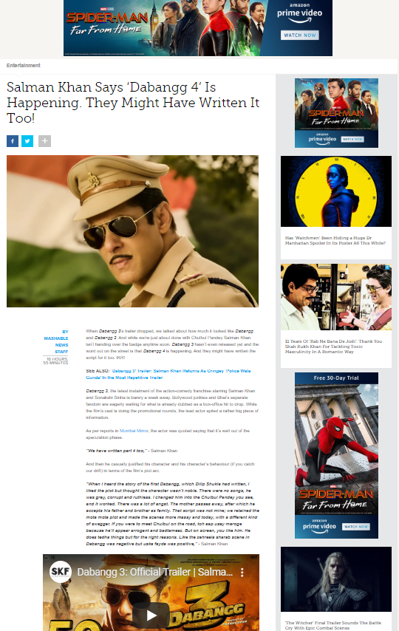
One of the popular article in Mashable

Slide 19
Thank You!

